Slide 1
Bayesian Learning
Lecture 8

Slide 2
Bayesian Classification: Why?
A statistical classifier: performs probabilistic prediction, i.e., predicts class membership probabilities
Foundation: Based on Bayes’ Theorem.
Performance: A simple Bayesian classifier, naïve Bayesian classifier, has comparable performance with decision tree and selected neural network classifiers
Incremental: Each training example can incrementally increase/decrease the probability that a hypothesis is correct — prior knowledge can be combined with observed data
Standard: Even when Bayesian methods are computationally intractable, they can provide a standard of optimal decision making against which other methods can be measured

Slide 3
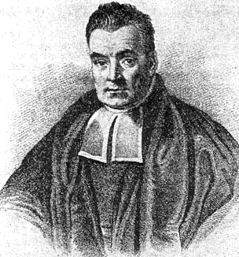
Introduction to Bayesian Learning
Basic Assumption
The observed data is governed by probability distributions
Features
Using prior knowledge on probability distributions
Incremental learning of probabilities
Each observed example can incrementally increase or decrease the estimated probability
Probabilistic predictions of target values
Prediction by multiple hypotheses
A standard of optimal decision making
Practical Algorithms
Naïve Bayes Classifier
Bayesian Belief Networks
Thomas Bayes
1702 - 1761

Slide 4
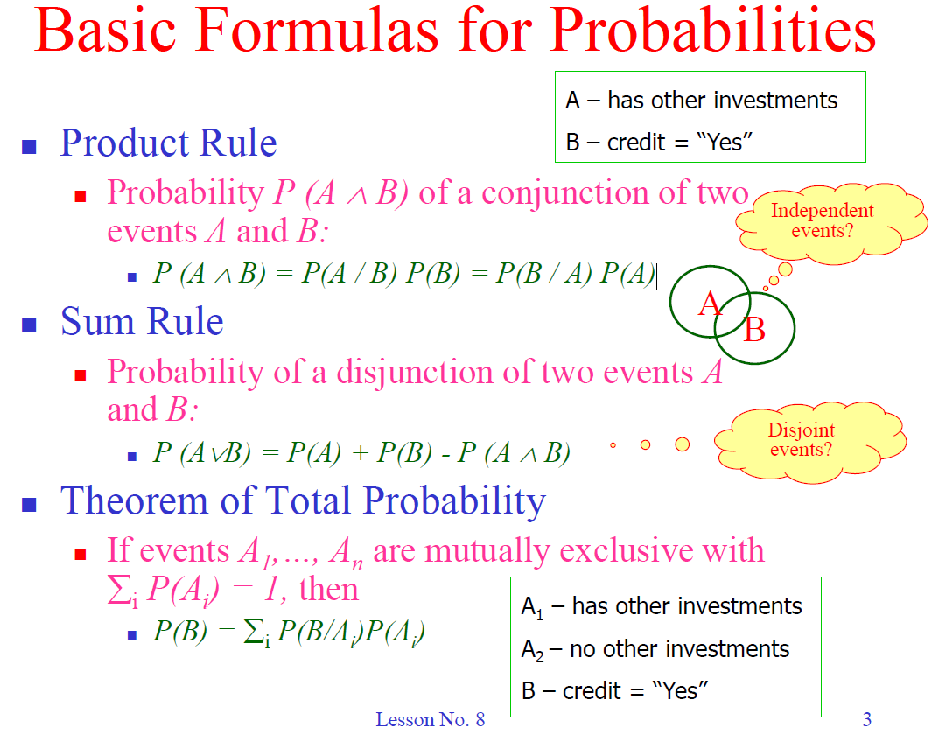

Slide 5
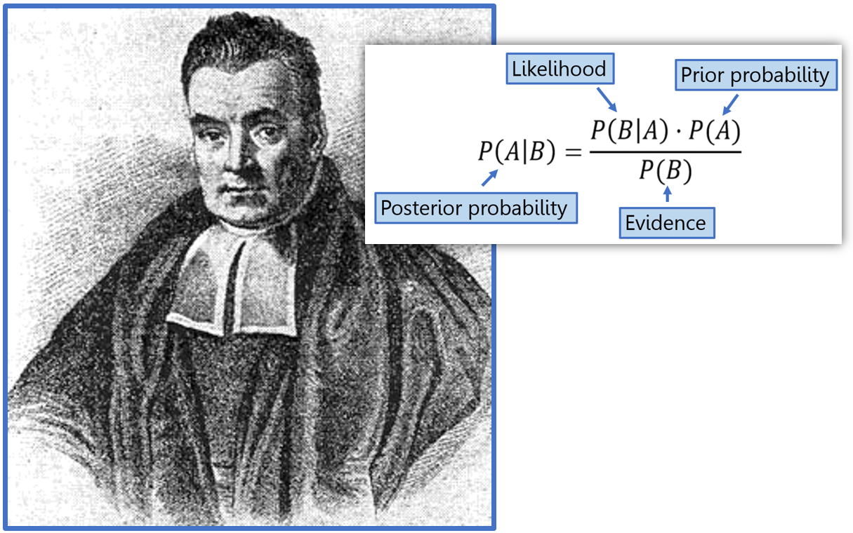
Introduction to Bayesian Learning

Slide 6
Bayesian Classification: Why?
A statistical classifier: performs probabilistic prediction, i.e., predicts class membership probabilities
Foundation: Based on Bayes’ Theorem.
Performance: A simple Bayesian classifier, naïve Bayesian classifier, has comparable performance with decision tree and selected neural network classifiers
Incremental: Each training example can incrementally increase/decrease the probability that a hypothesis is correct — prior knowledge can be combined with observed data
Standard: Even when Bayesian methods are computationally intractable, they can provide a standard of optimal decision making against which other methods can be measured

Slide 7
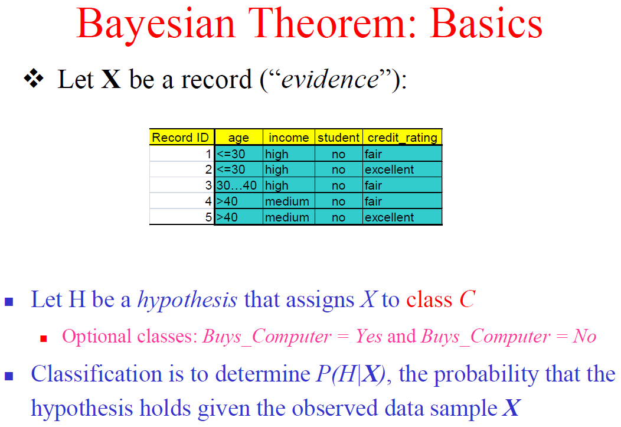

Slide 8
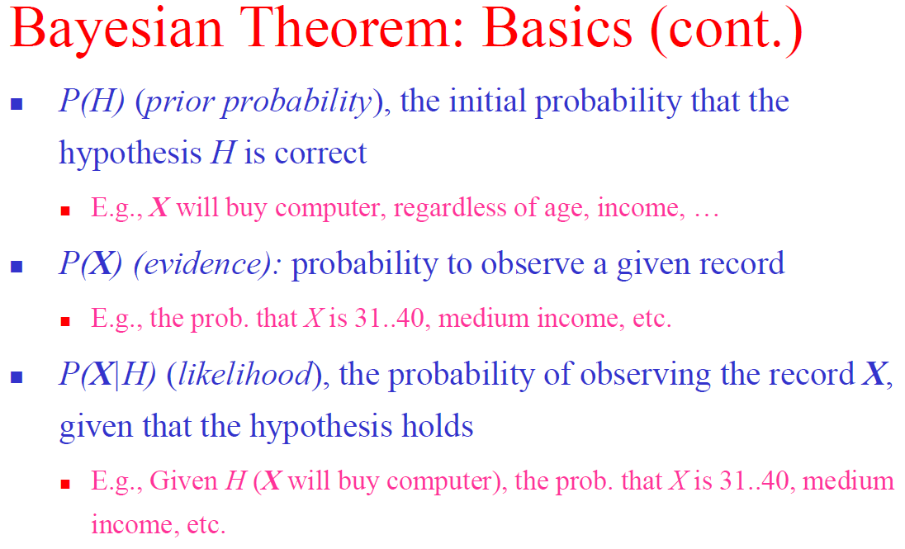

Slide 9
Bayesian Theorem: Basics
P(H) (prior probability): the initial probability that the hypothesis H is correct
P(X) (evidence): probability to observe a given record
P(X|H) (likelihood): the probability to observe record X, given that the hypothesis holds

Slide 10
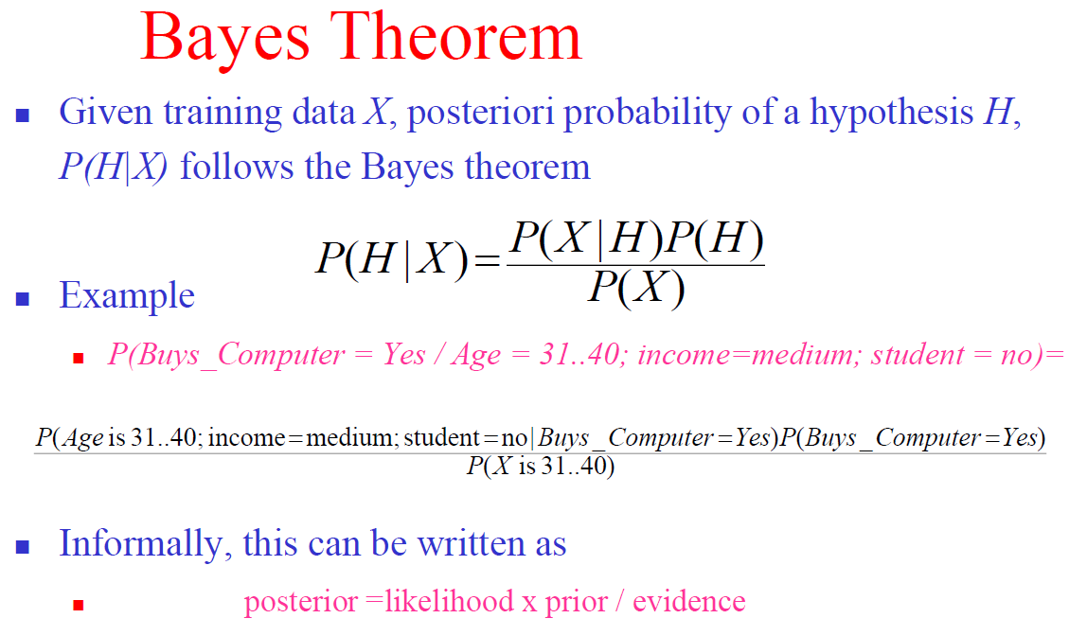

Slide 11
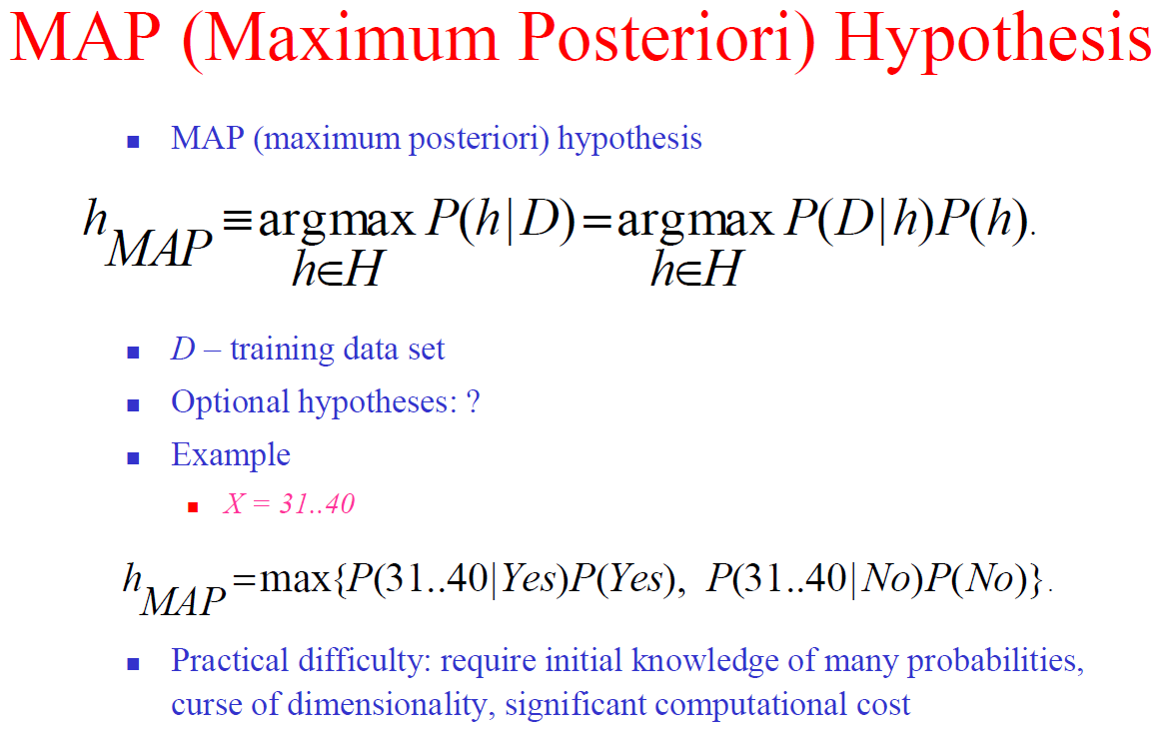

Slide 12
Bayes’ Theorem: Basics
Total probability Theorem:
Bayes’ Theorem:
Let X be a data sample (“evidence”): class label is unknown
Let H be a hypothesis that X belongs to class C
Classification is to determine P(H|X), (i.e., posteriori probability): the probability that the hypothesis holds given the observed data sample X
P(H) (prior probability): the initial probability
E.g., X will buy computer, regardless of age, income, …
P(X): probability that sample data is observed
P(X|H) (likelihood): the probability of observing the sample X, given that the hypothesis holds
E.g., Given that X will buy computer, the prob. that X is 31..40, medium income

Slide 13
Prediction Based on Bayes’ Theorem
Given training data X, posteriori probability of a hypothesis H, P(H|X), follows the Bayes’ theorem
Informally, this can be viewed as
posteriori = likelihood x prior/evidence
Predicts X belongs to C_{i} iff the probability P(C_{i}|X) is the highest among all the P(C_{k}|X) for all the k classes
Practical difficulty: It requires initial knowledge of many probabilities, involving significant computational cost

Slide 14
Classification Is to Derive the Maximum Posteriori
Let D be a training set of tuples and their associated class labels, and each tuple is represented by an n-D attribute vector X = (x₁, x₂, …, x_{n})
Suppose there are m classes C₁, C₂, …, C_{m}.
Classification is to derive the maximum posteriori, i.e., the maximal P(C_{i}|X)
This can be derived from Bayes’ theorem
Since P(X) is constant for all classes, only
needs to be maximized

Slide 15
Naïve Bayes Classifier
A simplified assumption: attributes are conditionally independent (i.e., no dependence relation between attributes):
This greatly reduces the computation cost: Only counts the class distribution
If A_{k} is categorical, P(x_{k}|C_{i}) is the # of tuples in C_{i} having value x_{k} for A_{k} divided by |C_{i, D}| (# of tuples of C_{i} in D)
If A_{k} is continous-valued, P(x_{k}|C_{i}) is usually computed based on Gaussian distribution with a mean μ and standard deviation σ
and P(x_{k}|C_{i}) is

Slide 16
Naïve Bayes Classifier
Let X be a data sample whose class label is unknown
X_{k} – The value of attribute k in the data sample
C_{i} – Class i
If P(X|C_{i}) is known, assign X to the class with maximum P(X|C_{i})*P(C_{i})
Notes:
מסווג naïve bayes מניח כי האפקט של ההערך של ה-attribute על קלאס מסוים הוא בלתי-תלוי בערך של ה-attributes האחרים. מטרת הנחה זו היא לפשט את החישובים הדרושים ובמובן זה האלגוריתם נחשב "נאיבי".

Slide 17
Naïve Bayes Classifier: Training Dataset
Class:
C1:buys_computer = ‘yes’
C2:buys_computer = ‘no’
Data to be classified:
X = (age <=30,
Income = medium,
Student = yes
Credit_rating = Fair)

Slide 18
Naïve Bayes Classifier: An Example
P(C_{i}): P(buys_computer = “yes”) = 9/14 = 0.643
P(buys_computer = “no”) = 5/14= 0.357
Compute P(X|C_{i}) for each class
P(age = “<=30” | buys_computer = “yes”) = 2/9 = 0.222
P(age = “<= 30” | buys_computer = “no”) = 3/5 = 0.6
P(income = “medium” | buys_computer = “yes”) = 4/9 = 0.444
P(income = “medium” | buys_computer = “no”) = 2/5 = 0.4
P(student = “yes” | buys_computer = “yes) = 6/9 = 0.667
P(student = “yes” | buys_computer = “no”) = 1/5 = 0.2
P(credit_rating = “fair” | buys_computer = “yes”) = 6/9 = 0.667
P(credit_rating = “fair” | buys_computer = “no”) = 2/5 = 0.4
X = (age <= 30 , income = medium, student = yes, credit_rating = fair)
P(X|C_{i}) : P(X|buys_computer = “yes”) = 0.222 x 0.444 x 0.667 x 0.667 = 0.044
P(X|buys_computer = “no”) = 0.6 x 0.4 x 0.2 x 0.4 = 0.019
P(X|C_{i})*P(C_{i}) : P(X|buys_computer = “yes”) * P(buys_computer = “yes”) = 0.028
P(X|buys_computer = “no”) * P(buys_computer = “no”) = 0.007
Therefore, X belongs to class (“buys_computer = yes”)

Slide 19
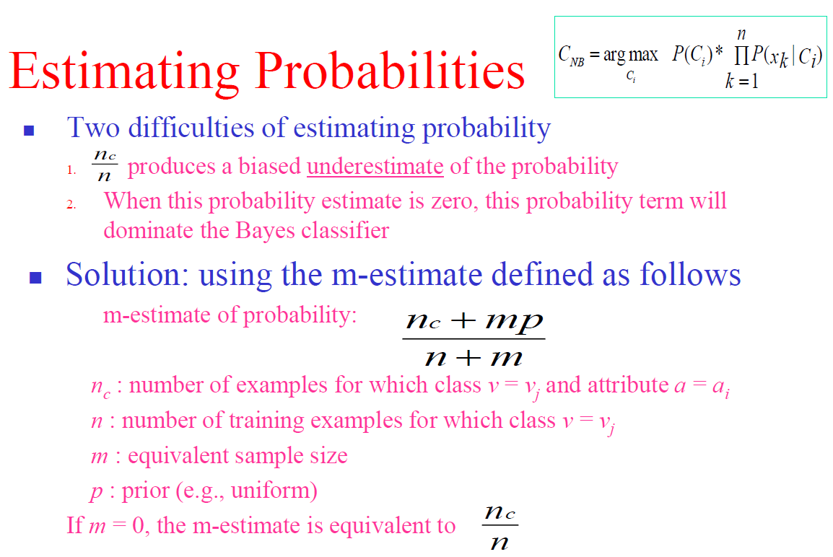

Slide 20
m-estimate
n_{c} : number of examples for which v = v_{j} and c = c_{i}
n : number of training examples for which c = c_{j}
m : equivalent sample size (constant, usually 2)
p : uniform prior (1/M, M – number of diff. values)
If m = 0, the m-estimate is equivalent to

Slide 21
Laplacian Estimate
Laplacian correction (or Laplacian estimate)
Add 1 to the numerator and K to the denominator
K – the number of different values in the attribute
The “corrected” prob. estimates are close to their “uncorrected” counterparts
Notes:
Data Mining (BGU) - Lecture No. 6
November 28, 2021
Prof. Mark Last
21

Slide 22
Naïve Bayes Classifier - Example
Decision
Using m-estimate
Data Sample:
X = (Credit history = unknown, Debt = high,
Collateral = Adequate,
Income >35)
Calculate using m-estimate

Slide 23
Naïve Bayes Classifier - Example
Data Sample: X = (Credit history = unknown, Debt = high, Collateral = Adequate, Income >35)
Probabilities (from the data):
P(high) = 5/14
P(moderate) = 4/14
P(low) = 5/14

Slide 24
Using m-estimate
Calculate P(x_{k}|C_{i}) for each k and i:
k = Credit History, X_{k} = unknown:
P(Credit history _{unknown} | Risk _{high}) =(2+2/3)/(5+2) =0.38
P(Credit history _{unknown} | Risk _{moderate}) =(1+2/3)/(4+2) = 0.28
P(Credit history _{unknown} | Risk _{low}) = (2+2/3)/(5+2) = 0.38
M=3 (Bad, Good, Unknown)
2 samples with both values
m = 2 , p = 1/3
5 samples with Risk = high

Slide 25
Calculate P(x_{k}|C_{i}) for each k and i:
k = Debt, x_{k} = high:
P(Debt high | Risk high)=(4+1)/(5+2) = 0.71
P(Debt high | Risk moderate)=(1+1)/(4+2)=0.33
P(Debt high | Risk low)=(2+1)/(5+2)=0.43
M=2 (Low, High)

Slide 26
Calculate P(x_{k}|C_{i}) for each k and i:
k = Collateral, x_{k} = adequate:
P(Collateral adequate | Risk high)=(0+1)/(5+2)=0.14
P(Collateral adequate | Risk moderate)=(1+1)/(4+2) =0.33
P(Collateral adequate | Risk low)=(2+1)/(5+2)=0.43
M=2 (None, Adequate)

Slide 27
Calculate P(x_{k}|C_{i}) for each k and i:
k = Income, x_{k} = > 35 :
P(income >35 | Risk high) = (0+2/3)/(5+2)= 0.1
P(income >35 | Risk moderate) = (1+2/3)/(4+2) = 0.28
P(income >35 | Risk low) = (5+2/3)/(5+2) = 0.81
M=3 (0-15, 15-35, >35)

Slide 28
Calculate P(X | C_{i}) for each i:
P(X | Risk _{high}) = 0.38*0.71*0.14*0.1=0.0037
P(X | Risk _{moderate}) = 0.28*0.33*0.33*0.28=0.0085
P(X | Risk _{low}) = 0.38*0.43*0.43*0.81=0.0569
P(Debt = high | Risk = high)
P(Credit history = unknown | Risk = high)
P(Collateral = adequate | Risk = high)
P(income >35 | Risk = high)

Slide 29
Calculate P(Ci)*P(X | Ci)
P(Risk high)*P(X | Risk high) = 5/14*0.0037 = 0.0013
P(Risk moderate)*P(X | Risk moderate) = 4/14*0.0085 = 0.0024
P(Risk low)*P(X | Risk low) = 5/14*0.0569 = 0.0203
Decision: X belongs to the class: Risk = low

Slide 30
Bayesian Belief Network
DAG (directed acyclic graph)
Nodes - set of random variables
Directed arrow from X to Y means that X has a direct influence on Y.
Each node has a CPT (conditional probability table) that quantifies the effects that the parents have on the node. The parents of a node are all those nodes that have arrows pointing to it.

Slide 31
Example
Smoke and radiation both cause cancer (but not only...).
Cancer cause fever and/or pain.
Fever and pain also caused by other diseases.

Slide 32
Example: Topology of Belief Network
Smoke
Radiation
Cancer
Fever
Pain

Slide 33
Example: CPT for Cancer Node
P(Cancer|Smoke,Radiation) True False
Smoke
Radiation
True True 0.750 0.250
True False 0.700 0.300
False True 0.600 0.400
False False 0.010 0.990

Slide 34
Example: Complete Belief Network
P(S)
0.100
P(R)
0.002
Smoke
Radiation
S R P(C|S,R)
T T 0.75
T F 0.70
F T 0.60
F F 0.01
Cancer
Fever
C P(F|C)
T 0.50
F 0.80
C P(P|C)
T 0.70
F 0.20
Pain

Slide 35
Classification
A generic entry in the joint probability distribution is the probability of a conjunction of particular assignments to each variable, such as:

Slide 36
Example: Probability Calculation
Calculate the probability of the event that the patient has a cancer but he never smoked and never got radiation, and felt both fever and pain.
P(F ^ P ^ C ^ ~S ^ ~R)
= P(F|C) P(P|C) P(C|~S,~R) P(~S) P(~R)
= 0.50 * 0.70 * 0.010 * 0.900 * 0.998
= 0.0031437
Notes:
36

Slide 37
Avoiding the Zero-Probability Problem
Naïve Bayesian prediction requires each conditional prob. be non-zero. Otherwise, the predicted prob. will be zero
Ex. Suppose a dataset with 1000 tuples, income=low (0), income= medium (990), and income = high (10)
Use Laplacian correction (or Laplacian estimator)
Adding 1 to each case
Prob(income = low) = 1/1003
Prob(income = medium) = 991/1003
Prob(income = high) = 11/1003
The “corrected” prob. estimates are close to their “uncorrected” counterparts

Slide 38
Naïve Bayes Classifier: Comments
Advantages
Easy to implement
Good results obtained in most of the cases
Disadvantages
Assumption: class conditional independence, therefore loss of accuracy
Practically, dependencies exist among variables
E.g., hospitals: patients: Profile: age, family history, etc.
Symptoms: fever, cough etc., Disease: lung cancer, diabetes, etc.
Dependencies among these cannot be modeled by Naïve Bayes Classifier

Slide 39
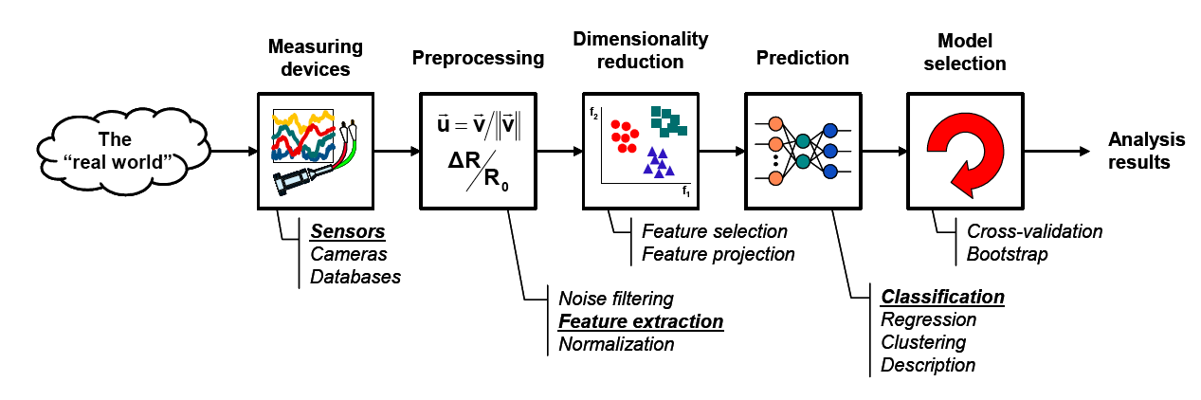
The learning process

